Slide 1
The Dutch Tulip Mania
Documentary on Tulip Mania
Dennis Chiu
Period 3

Slide 2
Overview of the Low Countries during the 17th Century
The Netherlands and Belgium, then the Spanish Netherlands and the United Provinces, served as the center of commerce on the European continent during the so-called “Dutch Golden Age” of the late-16th century into the 17th century.
Among the European nations, the United Provinces were the most tolerant towards race and religion, respecting the beliefs of Catholics, Protestants, and Jews (given that they kept their beliefs largely to themselves).
During the seventeenth century, the United Provinces ranked as one of the wealthiest regions in all of Europe, possessing large, efficient merchant fleets and an extensive shipbuilding industry. (Chambers)

Slide 3
The Law of Supply and Demand
In a market economy, supply is defined as the quantity of a product that sellers are willing to put on the market, while demand is defined as the quantity of the same product the buyers, or consumers, are willing to buy.
In general:
  Supply increases as a product’s price increases. Excessive supply leads to deflation, or a general decrease in the product’s value.
  Demand increases as a product’s price decreases. Excessive demand leads to inflation, or an overall increase in the product’s value.
The Dutch tulip mania embodied a severe financial bubble, a period of rapid inflation spurred by rapidly increasing demand for tulips, only to be followed by a crash, or a period of rapid deflation. (Heakal)

Slide 4
Background
The Dutch tulip craze of 1636-1637 is noted as one of the most famous examples of a financial bubble, or a drastic increase in prices based solely on the value investors place on a product, despite a product’s actual value. (Thompson)
While the rise in the tulip’s prices took place over the course of several decades in the late 16th century and early 17th century, the actual tulip craze only started during the fall and winter months of 1636, when prices rose at the highest rate. (see graph on Slide 11)

Slide 5
How the tulip came to Western Europe (late 16th- early 17th century)
For centuries prior to the tulip craze, the residents of Constantinople had considered the tulip an exotic luxury, obtained through trade with the Muslims and Ottoman Turks.
In the mid-sixteenth century, Dutch florists began to take notice of the rare flower, and began to cultivate the tulip in the late-sixteenth century.
Wealthy traders and high-class aristocrats were the first to participate in the tulip trade, in which tulip ownership was regarded as an indicator of taste and status. (Mackay)

Slide 6
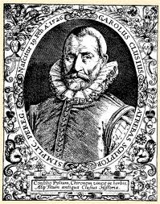
Carolus Clusius(1526-1609)
Humanist and botanist
Became professor of botany at University of Leiden in 1593
Credited with introducing the tulip, and the concept of tulip gardening for pleasure, to the Low Countries
First tulips planted in northern Netherlands in 1594 (“Carolus Clusius”)
Image source: clusiusstichting.nl

Slide 7
The bank system
After the popularization of currency and the decline of the Middle ages, most forms of currency were not standardized and/or subject to changes in value, based upon monarchical reforms or differing regional currencies.
The Bank of Amsterdam, established in 1609, created a reliable national currency for the United Provinces, preventing counterfeit and monopolizing the currency.
The Bank provided a system of transferring currency through book transfers, without using currency in their material state, but rather exchanging them through accounts.
  With this system, neither the currency nor a product had to be present for an exchange to take place. (French)
During the tulip mania, exchanges often were made for tulips that were either not directly exchanged or nonexistent to begin with: many tulips failed to be given to the buyer, while others had yet to even become fully grown.

Slide 8
The Tulip as a Status Symbol
Wealthy Dutch traders and florists were the first to popularize the tulip as a status symbol.
Soon, middle-class businessmen and merchants joined the craze, making the ownership of at least one tulip bulb an almost mandatory venture. (Mackay)
The most valuable tulips were the so-called “Broken” tulips, or multi-colored tulip blossoms, which were considered the most beautiful variety of tulip.
  Today, the colors of the coveted “Broken” tulips are known to be caused by a disease, which weakens the tulip, threatening its longevity and its ability to grow. (Beckmann)

Slide 9
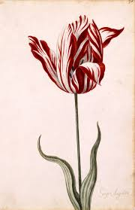
The “Broken” tulip
A picture of a Semper Augustus tulip, one of the rarest and most highly coveted tulips during the tulip mania.
Notice the white streaks that run up the petals. So-called “broken tulips” would possess this type of streak, and were more valuable.
(Image source: de.wikipedia.org)

Slide 10
The course of the tulip mania
Demand for tulips by the Dutch increased substantially in the 1630’s, when investors and speculators began to participate in the tulip trade for profit.
At this point, the tulip trade began to transition from an enterprise of owning tulips to a more capitalistic venture.
Many speculators and merchants mortgaged all of their property and depleted their savings to invest in just a few tulip bulbs. (Dash)
Prices rose at the highest rate during 1636. (see graph on Slide 11)
At their highest point on February 3, 1637, prices stood at some 2000% their value during 1636.
  A single rare tulip bulb could sell for twenty to thirty times a craftsman’s annual salary.
When Tulip prices fell after February 3, thousands of speculators lost their entire savings as tulips rapidly lost over 99% of their peak value. (Dash)
Once the bubble burst, even the most successful and wealthiest merchants and tulip-owners were left with nothing, save for ruined savings and worthless tulip bulbs.

Slide 11
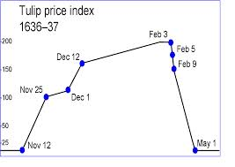
Graph of Tulip Prices (November 1636-May 1637)
Image source: wikipedia.org

Slide 12
Waermondt (True Mouth): You offer me a lot and I do not know whether I dare accept. I fear once I start, I will want to go on with it, again and again. And as one wave drives on another, so one deal would bring forth the other, and so, methinks, it is better I stay with my poor business and my own profession. I make no great profit and suffer no great loss.
Gaergoedt (Greedy Goods): That's well said. But could you not venture a little? You give no money till it's summer and then you have sold all your stuff; or if you have any on hand you plant it and it brings still more profit.
Waermondt: It is well for those who have enough money, but for me I do not find it good advice. For if I have a penny, I must put it into my business.
Gaergoedt: You can barely earn ten per cent on the money that is in your business, and even then only by giving a caution, but with Flora it is cent for cent. Yes, ten for one, a hundred for one, and sometimes a thousand.
Waermondt: Vainly have I done such hard labor, and have many parents slaved and toiled. What need is there for merchants to have any style, or to risk their goods overseas, for the children to learn a trade, for the peasants to sow and to work so hard on the soil, for the skipper to sail on the terrible and dangerous seas, for the soldier to risk his life for so little gain, if one can make profits of this sort?
Waermondt and Gaergoedt
A satirical passage from The Rise and Decline of Flora (1637) criticizing the tulip mania.
Also demonstrates the motivation of Dutch traders in enormous profits through tulip speculation.
(Posthumus)

Slide 13
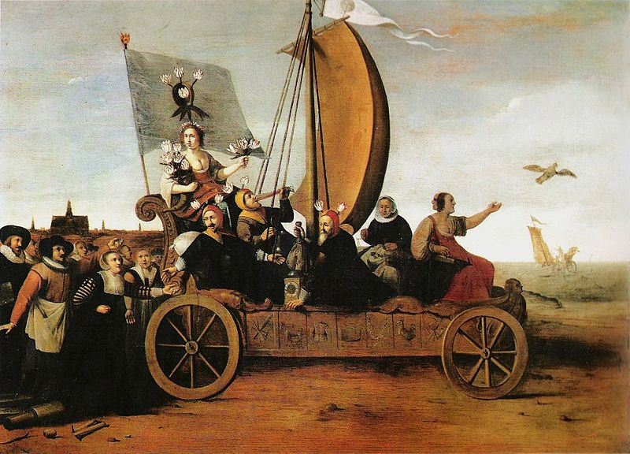
Flora’s Mallewagen
A painting by Sir Heinrik Pot satirizing the tulip craze.
Note the workers dropping their tools on the left, as well as the man drinking on the cart.
The cart on which Flora is standing, holding bunches of tulips, is shown riding towards the sea.
(Image source: wikimedia.org)
[Click here for a larger image]

Slide 14
Aftermath
After the speculative bubble burst, resulting the subsequent economic ruin of nearly all participating merchants in the tulip trade, traders and tulip-owners sought governmental assistance.
Despite initial reluctance, the government in Amsterdam resolved to cancel all commercial contracts made during the tulip mania period, in order to free merchants from their now-worthless and irreparable contracts.
Ultimately, however, the government proved incapable of resolving the economic crisis, and the ruined tulip merchants remained poor. (Mackay)
  The latter half of the seventeenth century saw an overall decline in Dutch superiority over European trade, just a few decades following the years of the tulip mania. (Chambers)
Following the collapse, many pamphlets and paintings (see previous and following slide) were produced opposing and satirizing the folly of the tulip mania.

Slide 15
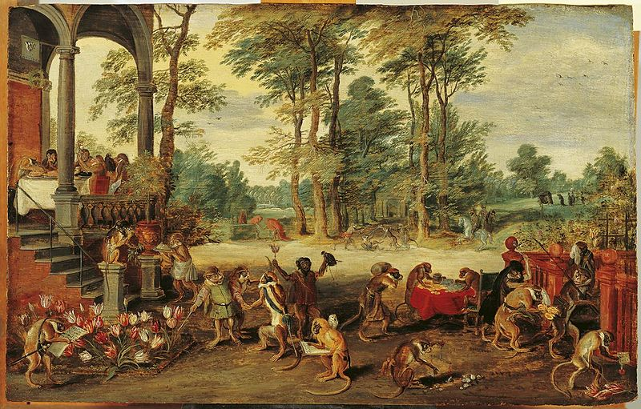
Jan Bruegel the Younger, Satire on Tulip Mania (1640)
A painting mocking tulip traders and dealers, portraying them as monkeys.
At the bottom-right, a monkey is shown urinating on a bouquet of tulips, now apparently worthless.
(Image source: commons.wikimedia.org)
[Click here for larger image]

Slide 16
From an Economic Perspective
The “tulip mania,” though a controversial example, is often cited as the first and/or the greatest example of a financial bubble.
As shown in the tulip mania, a bubble is a general term for two occurrences: a period of gradual yet accelerating inflation, followed by a panic and a rapid deflation in prices.
  Increasing demand and speculation in the Dutch tulip craze drove prices steadily upward during the 1630’s, an increase that gained momentum in the years leading up to the 1637 crash. During this period, the public sought to buy tulips over selling tulips due to the rising prices and the potential for profit.
  After the 1637 crash, the tulip craze entered a period of rapid deflation, during which prices drastically fell throughout the course of a few months (though some estimates place the crash as having happened within a few weeks). This deflationary period resulted in a seller’s market, with tulip owners seeking to sell their tulips before their tulips became entirely worthless. (“Tulipmania [Tulipomania]”)

Slide 17
roots of the bubble/crash
The Bubble:
  Carolus Clusius’s introduction of the tulip to the Netherlands, along with the concept of tulip gardening, made the tulip a marketable Dutch product (“Carolus Clusius”).
  The rarity and long growth period of the bulbs themselves, despite their value, made the tulip a very scarce commodity (Veen).
    During the 1620’s, every bulb of the Semper Augustus tulip, known as among the most precious of tulip varieties, lay in the possession of a single owner.
The Crash:
  Speculation and a new bank exchange system enabled and encouraged false transactions. An arranged payment often never reached the seller, and tulips often were sold via contract and never delivered to the buyer (French).
  A sudden decrease in demand after February 3 of 1637, when prices were at their peak, led to a large-scale panic due to rapid deflation of the tulip’s value.

Slide 18
Summary of the Dutch Tulip Mania
The early seventeenth century saw an increase in florists and merchants’ demand for tulip bulbs.
Cultivated tulips were less hardy than uncultivated varieties, but were considered more beautiful, and thus were more highly coveted. (Mackay)
Inflation due to increased demand led to rapidly rising prices, particularly through 1636, following by a rapid deflation due to decreasing demand.
At the height of the mania, in February 1637, a particular Viceroy tulip bulb could sell for 4,200 guilders. (Tulipmania)
  In comparison, a skilled craftsman could make about 150 guilders annually.
After February 1637, prices crashed drastically. By May the same year, prices fell by at least 95% of their February value. (Tulipmania) For some tulips, the annualized rate of decrease in their prices was as high as 99.999%! (Thompson)

Slide 19
Works Cited
Beckmann, Johann. A History of Inventions and Discoveries. Vol. 1. N.p.: N.p., 1817. Print.
Chambers, Mortimer. The Western Experience. 9th ed. Boston: McGraw-Hill, 2007. Print.
French, Doug. "The Truth About Tulipmania." The Ludwig Von Mises Institute. Mises.org, 26 May 2007. Web. 17 Mar. 2014. <http://mises.org/daily/2564>.
Heakal, Reem. "Supply and Demand." Investopedia. Investopedia.com, n.d. Web. 16 Mar. 2014. <http://www.investopedia.com/university/economics/economics3.asp>.
Mackay, Charles. "Memoirs of Extraordinary Popular Delusions and the Madness of Crowds." Library of Economics and Liberty. N.p., n.d. Web. 17 Mar. 2014. <http://www.econlib.org/library/Mackay/macEx3.html>.
Posthumus. "Waermondt and Gaergoedt." Tulipmania (Tulipomania). UChicago.edu, n.d. Web. 17 Mar. 2014. <http://penelope.uchicago.edu/~grout/encyclopaedia_romana/aconite/tulipomania. html>.

Slide 20
Works Cited (continued)
Thompson, Earl A. "The Tulip Mania: Fact or Artifact?" Ucla.edu. Ucla.edu, 12 Mar. 2006. Web. 17 Mar. 2014.
"Tulip Speculation and Crash, 1637." Umassd.edu. N.p., N.d. Web. 13 Mar. 2014.
"Tulipmania." Investopedia. Investopedia.com, n.d. Web. 17 Mar. 2014. <http://www.investopedia.com/terms/t/tulipmania.asp>.
"Tulipmania (Tulipomania)." Tulipmania (Tulipomania). UChicago.edu, N.d. Web. 17 Mar. 2014.
Veen, Mauritz Van Der. "The Social Politics of a Financial Bubble." Uga.edu. Uga.edu, Mar. 2009. Web. 18 Mar. 2014.

